Slide 1
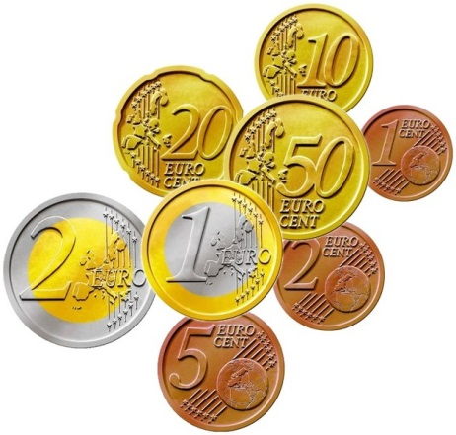


My Probability Interactive Notebook
Name
Class
Teacher
Term 1 Semester 1
1

Slide 2
Create your own front page
It needs to contain the following –
My number interactive notebook
Name
Class
Teachers Name
Semester 1 Term 1
Page number 1

Slide 3
Contents
Glossary or Formula Page
Page
Date
Description
2
3

Slide 4
Tasks
24
7
30
Essential Question
Questions
Notes
Summary
4
5

Slide 5
Task One
Three letters are chosen from the work MATH without replacement.
Find Pr(MAT)
Start by listing the outcomes

Slide 6
Task One
Three letters are chosen from the work MATH without replacement
Find Pr(MAT)
Start by listing the outcomes
What problems did you encounter in solving this problem?

Slide 7
24
7
30
Date
Tree Diagrams
EQ – How can I list the outcomes for multiple events?
Tree diagrams list the sample space for multistage experiments
9

Slide 8
24
7
30
Date
Tree Diagrams
EQ – How can I list the outcomes for multiple events?
Tree diagrams list the sample space for multistage experiments
Example : Two letters are chosen from the work MATH without replacement
9

Slide 9
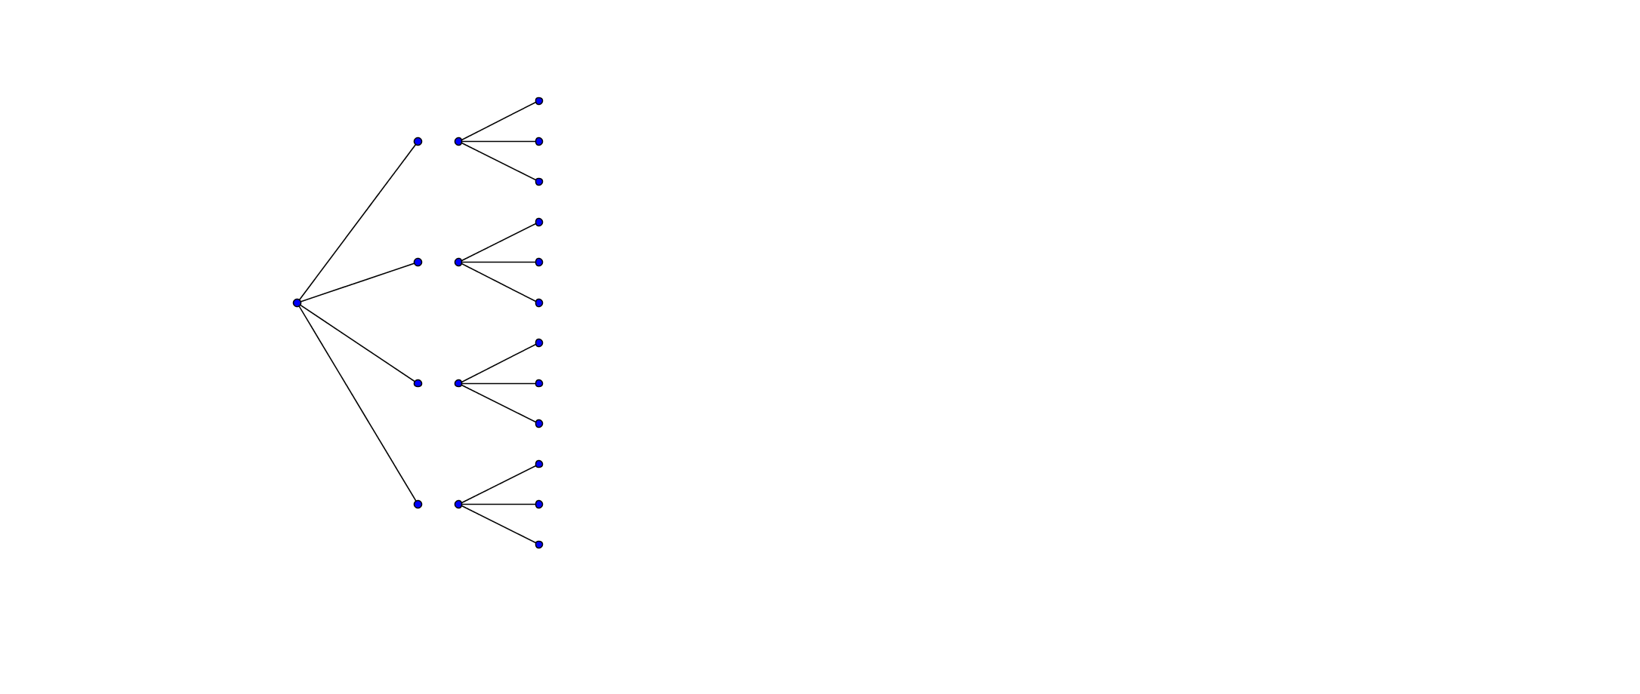
24
7
30
Date
Tree Diagrams
EQ – How can I list the outcomes for multiple events?
Tree diagrams list the sample space for multistage experiments
Example : Two letters are chosen from the work MATH without replacement
1st Letter
M
A
T
H
9

Slide 10
24
7
30
Date
Tree Diagrams
EQ – How can I list the outcomes for multiple events?
Tree diagrams list the sample space for multistage experiments
Example : Two letters are chosen from the work MATH without replacement
2nd Letter
1st Letter
A
T
H
M
T
H
M
A
H
MA
T
M
A
T
H
9

Slide 11
24
7
30
Date
Tree Diagrams
EQ – How can I list the outcomes for multiple events?
Tree diagrams list the sample space for multistage experiments
Example : Two letters are chosen from the work MATH without replacement
2nd Letter
Outcome
1st Letter
A
T
H
M
T
H
M
A
H
MA
T
MA
MT
MH
AM
AT
AH
TM
TA
TH
HMHA
HT
M
A
T
H
9

Slide 12
24
7
30
Date
Tree Diagrams
EQ – How can I list the outcomes for multiple events?
Tree diagrams list the sample space for multistage experiments
Example : Two letters are chosen from the work MATH without replacement
2nd Letter
Outcomes
1st Letter
A
T
H
M
T
H
M
A
H
MA
T
MA
MT
MH
AM
AT
AH
TM
TA
TH
HMHA
HT
M
A
12
Outcomes
T
H
9

Slide 13

24
7
30
Date
Tree Diagrams
EQ – How can I list the outcomes for multiple events?
Example : Two letters are chosen from the work MATH without replacement
2nd Letter
Outcomes
1st Letter
A
T
H
M
T
H
M
A
H
MA
T
MA
MT
MH
AM
AT
AH
TM
TA
TH
HMHA
HT
M
A
12
Outcomes
T
H
9
Find $\operatorname{Pr}\left(AT\right)=\frac{1}{12}$

Slide 14
Task Two
Page 527-529

Slide 15
Fill in the questions on your Cornell Notes

Slide 16
Notes Review
24, 7 ,30
Date
Title
Essential question
Notes complete
Notes complete with colour and diagrams
Questions completed
Contents page filed in
Formula page filled in

Slide 17
Homework
Review your notes and write a summary answering the essential question.

